Slide 1

Visualization-Based Technical Presentation on Growth Functions
CSA0615 – DESIGN AND ANALYSIS OF ALGORITHMS
GUIDED BY:
DR. NAGARAJAN
DONE BY:
JABARAJ T (192511187)

Slide 2


INTRODUCTION
What is an Algorithm?
An algorithm is a finite sequence of steps used to solve a computational problem.
As the input size (n) increases, algorithms require different amounts of execution time.
To compare algorithms independently of hardware, we use Asymptotic Analysis.
Objective
Understand algorithm efficiency.
Compare growth functions.
Visualize performance.
Select the best algorithm for large datasets.

Slide 3
PROBLEM STATEMENT
Problem
Different algorithms solve the same problem but consume different execution times.
Question
Which algorithm performs better when input size becomes very large?
Solution
Analyze and compare:
O(log n)
O(n)
O(n log n)
O(n²)
O(2ⁿ)
using mathematical and graphical analysis.

Slide 4
GROWTH FUNCTIONS
Growth Function | Name | Efficiency
O(log n) | Logarithmic | Excellent
O(n) | Linear | Very Good
O(n log n) | Linearithmic | Good
O(n²) | Quadratic | Poor
O(2ⁿ) | Exponential | Very Poor

Slide 5
MATHEMATICAL COMPARISON
n | log₂n | n | n log₂n | n² | 2ⁿ
1 | 0 | 1 | 0 | 1 | 2
2 | 1 | 2 | 2 | 4 | 4
4 | 2 | 4 | 8 | 16 | 16
8 | 3 | 8 | 24 | 64 | 256
16 | 4 | 16 | 64 | 256 | 65,536
32 | 5 | 32 | 160 | 1,024 | 4,294,967,296
Observation
Exponential growth becomes impractical very quickly.

Slide 6
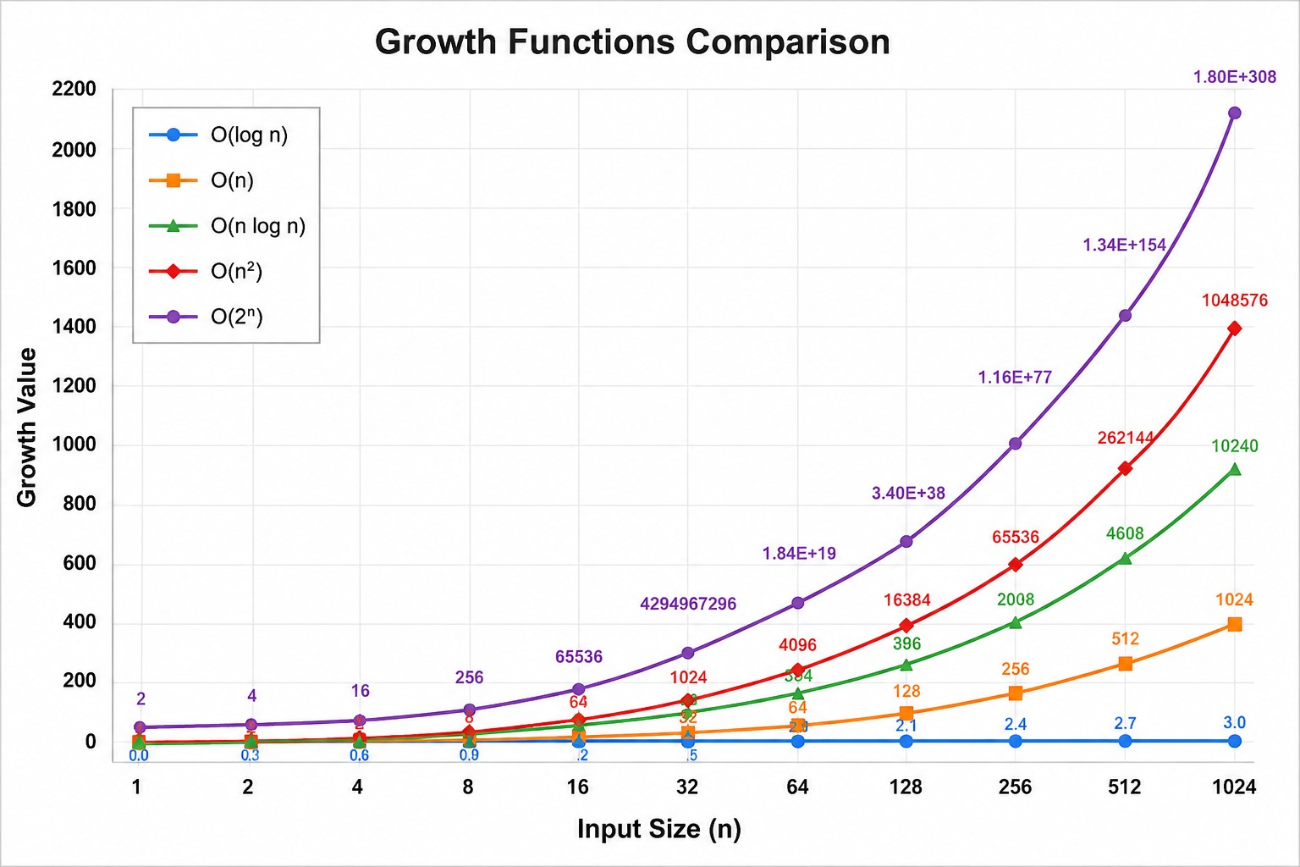
GRAPH
Observation:
Logarithmic grows very slowly.
Linear increases steadily.
Linearithmic grows slightly faster.
Quadratic rises rapidly.
Exponential shoots almost vertically.

Slide 7
PRACTICAL EXAMPLES
Complexity | Example Algorithm
O(log n) | Binary Search
O(n) | Linear Search
O(n log n) | Merge Sort
O(n²) | Bubble Sort
O(2ⁿ) | Recursive Fibonacci

Slide 8
COMPARATIVE ANALYSIS
O(log n)
Fastest
Best for huge datasets
O(n)
Efficient
Simple
O(n log n)
Best sorting algorithms
O(n²)
Acceptable only for small inputs
O(2ⁿ)
Extremely slow
Used only for special problems

Slide 9
ALGORITHM SELECTION
Problem Size | Recommended Complexity
Small | O(n²) acceptable
Medium | O(n log n)
Large | O(log n) or O(n)
Very Large | O(log n) preferred

Slide 10
CONCLUSION
Growth functions determine algorithm efficiency.
Lower-order growth performs better.
O(log n) is the most scalable.
O(n log n) is ideal for sorting.
O(2ⁿ) should be avoided for large inputs.
Choosing the correct algorithm significantly improves performance.

Slide 11
APPLICATIONS
Growth function analysis is used in:
Artificial Intelligence
Machine Learning
Search Engines
Big Data Analytics
Cloud Computing
Database Systems
Computer Networks
Operating Systems

Slide 12
REFERENCES
Thomas H. Cormen et al., Introduction to Algorithms, 4th Edition, MIT Press, 2022.
Donald E. Knuth, The Art of Computer Programming. Steven Skiena, The Algorithm Design Manual.
Michael T. Goodrich, Data Structures and Algorithms in Python.
NPTEL – Design and Analysis of Algorithms.

Slide 13
THANK YOU

